Slide 1
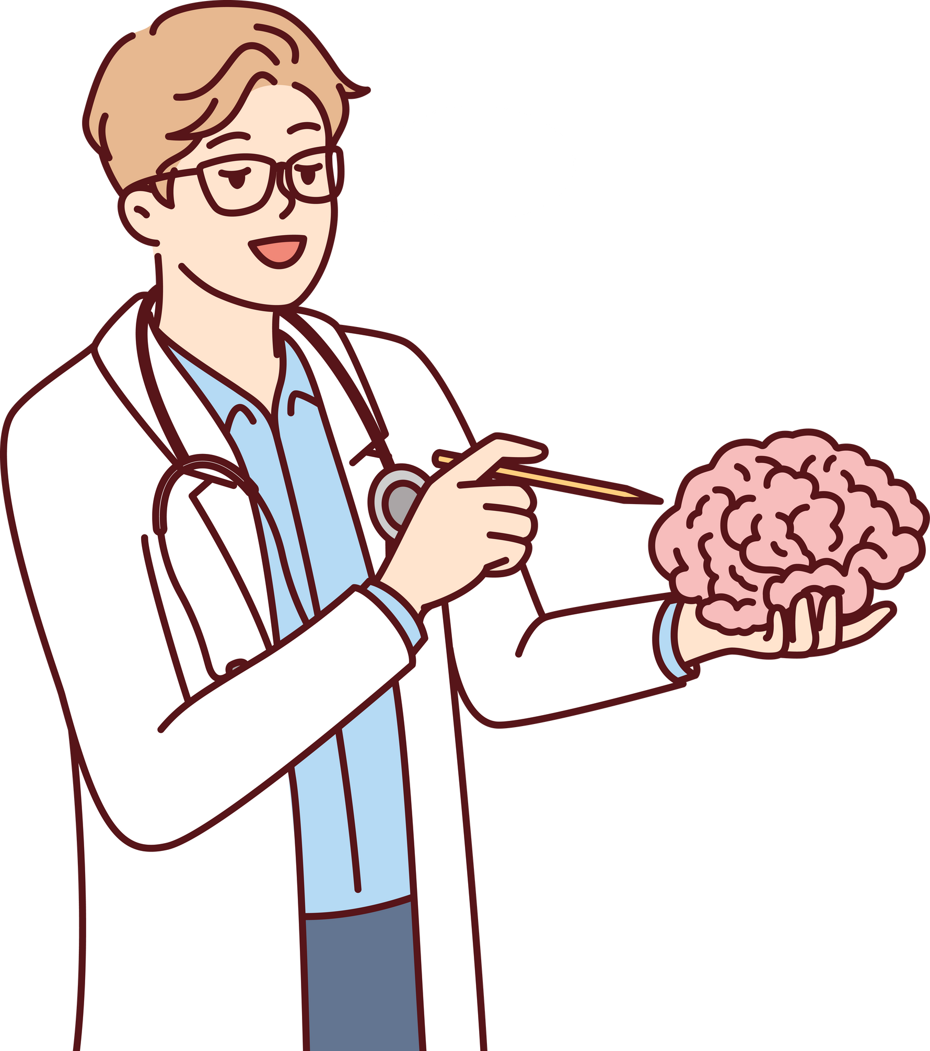

TRANSFORMING MEDICAL DIAGNOSIS WITH AUGMENTED REALITY
PRESENTATION 2024
Presented by
Amarnath (Ash)

Slide 2




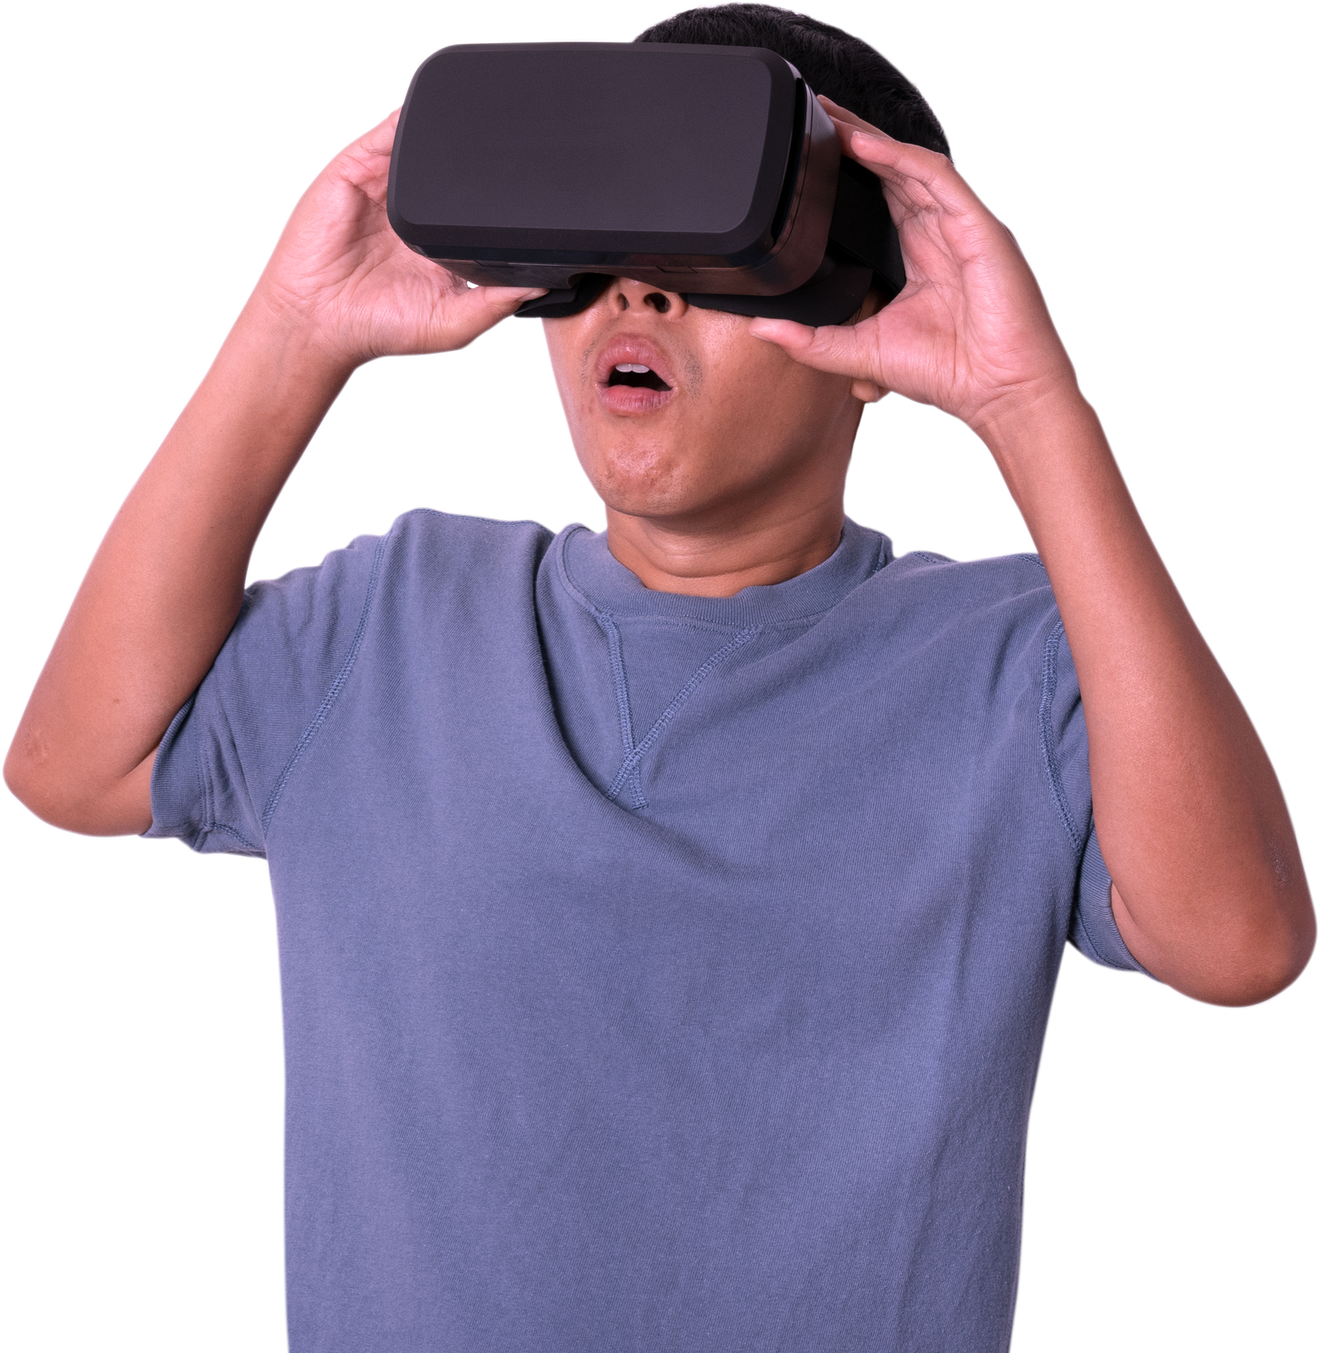

AGENDA
01
ABOUT ME
02
CHALLENGES
03
SOLUTION
04
USER BASE & SCOPE
05
TECHNICAL FOUNDATION
06
IMPLEMENTATION
07
FUTURE DIRECTIONS
03
HEADING TEXT
04
HEADING TEXT

Slide 3


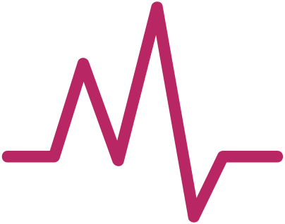
About Me
I am an interdisciplinary researcher with a passion for leveraging emerging technologies to transform the medical field. My goal is to develop innovative solutions that can reduce the time required for diagnosis and treatment while also making the healthcare experience easier and more accessible for both professionals and patients. This AR medical imaging application is a continuation of my previous work in the realm of AI-powered medical image analysis.
Amarnath

Slide 4

Challenges
01
02
03
Cognitive overload due to the need to switch between multiple systems and displays to access time-sensitive critical patient data
Cognitive overload for healthcare professionals due to the need to switch between multiple systems and displays to access critical patient data
Difficulty in accurately visualizing and interpreting complex 3D medical scans, such as MRI and CT images
Time-consuming manual review and analysis of medical imaging leading to potential delays in diagnosis and treatment

Slide 5




Solution
Immersive 3D visualization of medical scans, allowing healthcare professionals to intuitively examine and interpret anatomical structures and abnormalities using AR devices.
Automated detection, classification, and analysis of medical features using advanced computer vision and machine learning algorithms.
Integrated display of critical patient information, including imaging data, medical records, and analytical insights, all within a single AR interface.

Slide 6

User Base and Scope
Scope: Initially, our focus will be on regional US markets, allowing us to refine and tailor our solution to meet specific needs. However, we have robust plans for national and global expansion, targeting major hospitals, medical centers, and healthcare networks.
Projected User Base: Our AR healthcare solution anticipates serving a user base in the thousands globally, comprising medical professionals who require advanced imaging analysis tools.

Slide 7
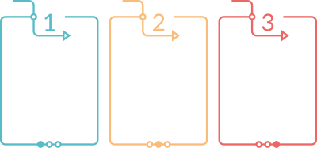
Technical Foundation
AI Integration for real-time analysis and classification of medical imaging data. These algorithms enable accurate and efficient detection and characterization of anomalies, enhancing diagnostic capabilities.
Seamless integration of patient records to access patient information alongside imaging data. Our solution also facilitates remote collaboration, allowing medical teams to collaborate effectively regardless of geographical barriers.
Our solution is compatible with Microsoft HoloLens 2, providing users with an immersive and intuitive experience with top-notch security, privacy, and reliability, which are scalable for growing demand.

Slide 8


Implementation
Our solution provides healthcare professionals with intuitive visualization and automated analysis capabilities. This has the potential to streamline workflow, improve accuracy, and ultimately enhance patient care.
We anticipate significant growth for our AI-AR healthcare solution within the medical community. We expect strong demand driven by the need for advanced imaging analysis tools.
We plan to introduce our AR solution through research, security measures, validation studies, and collaborative partnerships to build trust and drive adoption within the medical community.
Partnership with hospitals, medical centers, and healthcare networks to facilitate widespread adoption to ensure the seamless integration of our solution into existing healthcare systems.

Slide 9

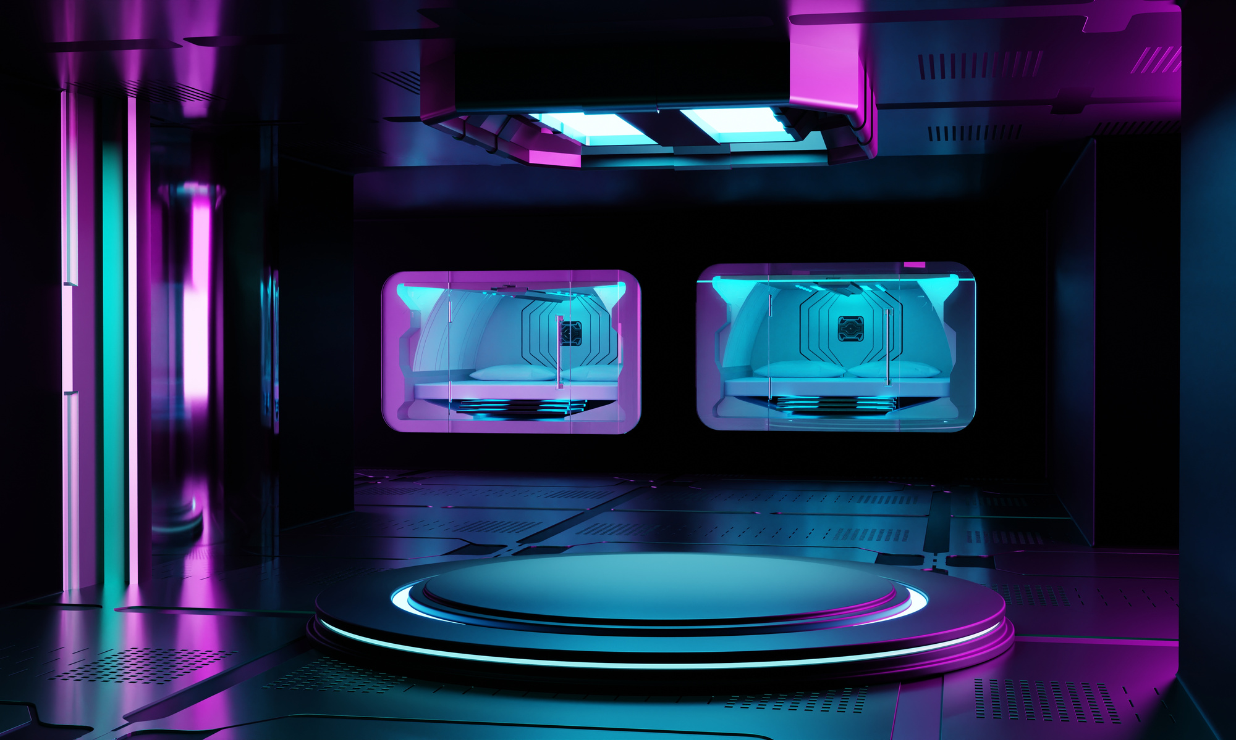

FUTURE DIRECTIONS
Incorporation of diverse diagnostic modalities such as PET scans, ultrasound, and genetic testing, enabling comprehensive patient assessments.
Seamless integration with medical equipment like heart monitors, blood pressure cuffs, and glucose meters for real-time data streaming and analysis.
Integrated data from various sources, including diagnostic tests, patient history, and treatment plans, to facilitate collaborative decision-making among specialists and optimize personalized patient care plans.

Slide 10

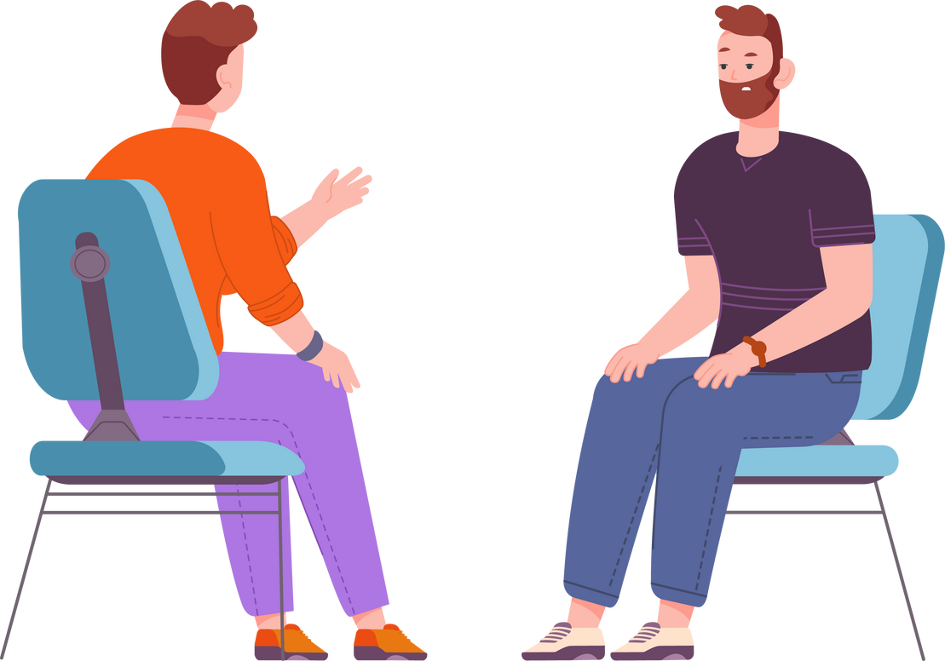
ANY
QUESTIONS?

Slide 11

THANK
YOU

